Slide 1
What do you remember about video 3 ?
The shepherds were on the hillside near which town?
2. When the angel appeared to the
shepherds, it said, “ Do not _ _
_ _ _ _ _ _
3. The angel said it had good news this day
for all people. This would take place in
the town they were near. What did the
angel call the town ?

Slide 2
4. The angel said to the shepherds that the baby
would be the S_ _ _ _ _ _ r of all people and
he is C_ _ _ _ _ the Lord.
What clues did the angel give the shepherds
about where they would find him ?
6. When all the angels joined the first one,
who did they say glory was to go to ?

Slide 3
7. The shepherds went and found the baby in the
manger and in the Bible it says they went and
told people about the child they had visited and
the people were amazed. On the way back to
the hillside, what was it the shepherds kept
doing ?
For a bonus….why wasn’t there any mention of the wise men in the story ?

Slide 4
How did you do?.
Bethlehem.
2. The angel said, “Do not be afraid.”
3. The angel called Bethlehem the town of David.
4. The baby would become the Saviour of all
people because he is Christ the Lord.
Remember, Jesus’ name means, ‘He will
save,’ and Christ means chosen or anointed
one. (Continued on next page.)

Slide 5
In those days, once the next king had
been chosen his head was anointed with oil to
show he had been chosen to be king. By
saying Jesus was the Christ, the angel was
saying he would become a king.
They would find the baby in a feeding-box, or manger, and he would be wrapped in cloths.
6. The group of angels said, “Glory to God and
peace to all people.”
7. The shepherds returned to the hillside praising
God for all the things they had seen and heard.
Bonus…the wise men didn’t come and visit Jesus until Jesus was a bit older so they wouldn’t have been there at the same time as the shepherds.

Slide 6
Bonus…the wise men didn’t find out about Jesus until later, so they couldn’t have been there at the same time as the shepherds.

Slide 7
Try out one or more of these activities
Find pictures of some people in the clothes that they would have worn when Jesus lived. For example, a man and woman, a shepherd, a Roman soldier. Sketch each one, or cut them out , stick onto paper and label each one.
Make a list of anagrams of key words from any part of the story.

Slide 8
Write down five bulleted points in order to retell
the shepherds’ story.
Work with a partner to play a game of true or false. Take it turns to ask each other questions about the story that can only be answered true or false.
For example…
Mary went to a good hospital to have her
baby . T or F?
An angel said that Mary’s baby would be called
Jesus. T or F?
The Persian army ruled over the country where
Jesus was born. T or F?

Slide 9
See if you can retell the whole of the story in just three sentences. Each sentence must begin with the name, ‘Mary.’ See how short can you make each sentence and still include the main points.
Quick questions just to finish.
(The answers may not come from what you
have seen or heard.)
Someone who is a follower of Jesus Christ is called a _ _ _ _ _ _ _ _ _.
Jesus’ birth happened about 2020 years ago. True or false ?

Slide 10
In the time when Jesus’ lived, people who had read the scriptures knew it was foretold that the Messiah would be born in Bethlehem.
True or false?
Sometimes, when dates from the past are written, they have B.C. after them. What does B.C. stand for?
What was the name of the king at the time Jesus was born, who later tried to have Jesus
killed?

Slide 11
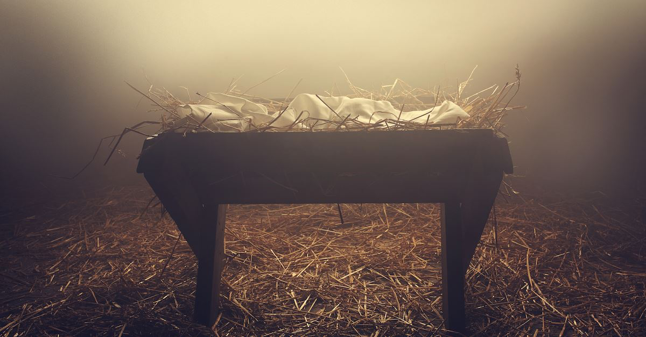
Everyone at
Christian Schools Workers Hastings
would like to wish all the children, staff and families at your school or academy,
a very happy Christmas.

